Slide 1
DATA 230 Data Visualization Week 3
Department of Applied Data Science San Jose State University Instructor: Robert Nicholson
sjsu.edu/people/robert.nicholson

Slide 2
Reminder: Submit Examples!
Good, bad or interesting visualizations
Include explanation of why it is noteworthy
25 points if I use your example in class

Slide 3
Data Analytics and Visualization in Microsoft Excel
Google Sheets
Apple Numbers

Slide 4
Why Use a Spreadsheet
Easy to explore data
Easy to share data
Easy to chart data

Slide 5
What is Microsoft Excel?
Excel definition: a software program created by Microsoft that uses spreadsheets to organize numbers and data with formulas and functions. Excel analysis is ubiquitous around the world and used by businesses of all sizes to perform financial and business analysis.
First released in 1985
More than 25 years of development

Slide 6
Why Use Excel?
PROS
Ubiquitous in the business world – easy to share
Interactive
Powerful
Programmable (but does not require programming)
Imports CSV files
Integrates with MS Word and Powerpoint
Integrates with Power BI (business intelligence)
CONS
You need to pay for it
Can’t handle “big data”
Your colleagues will laugh at you

Slide 7
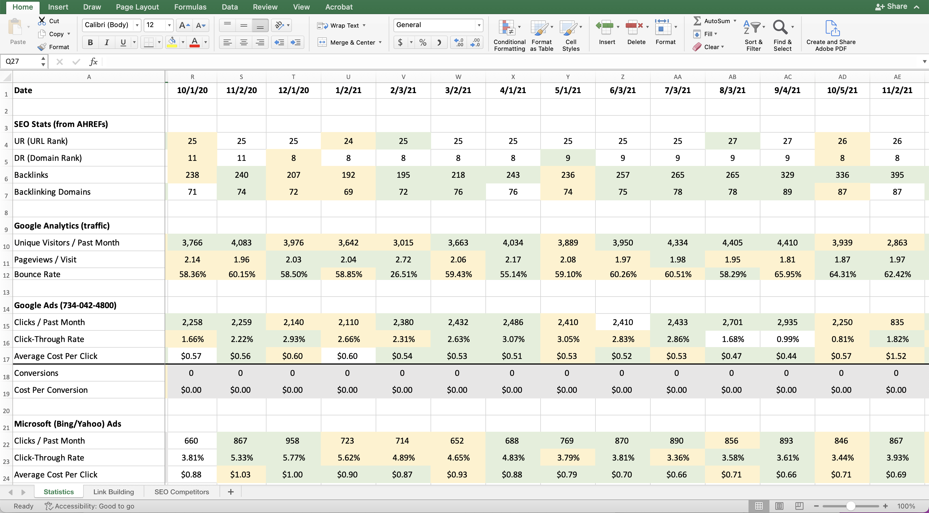
Microsoft Excel

Slide 8
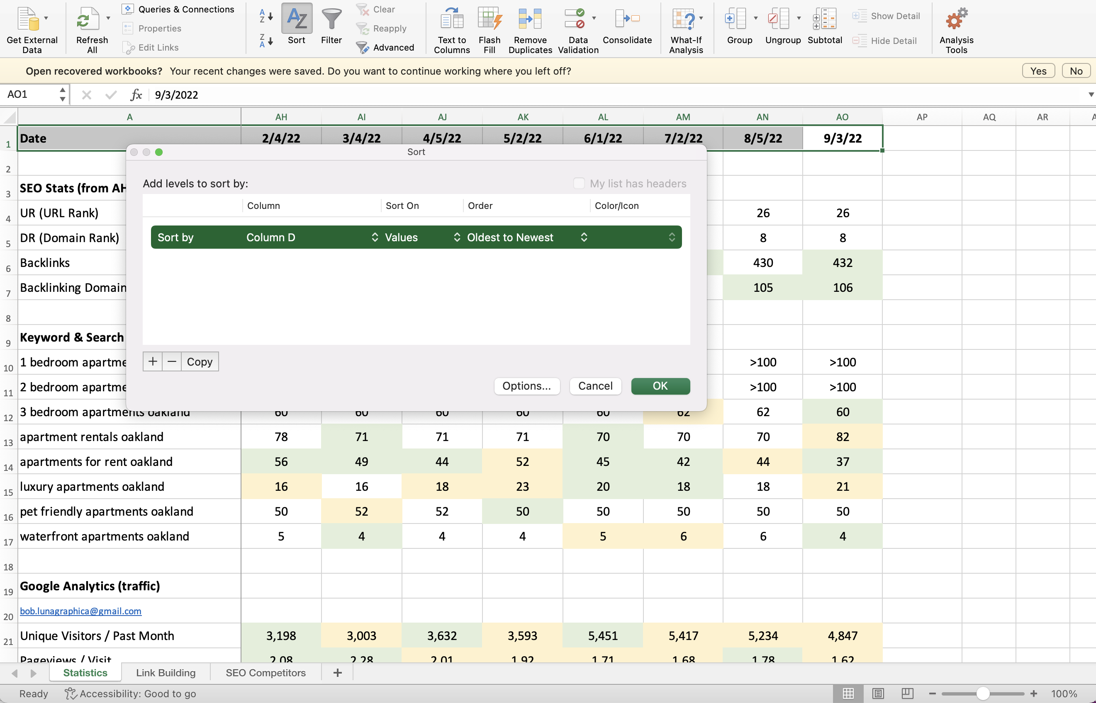
Easy to Rearrange Data

Slide 9
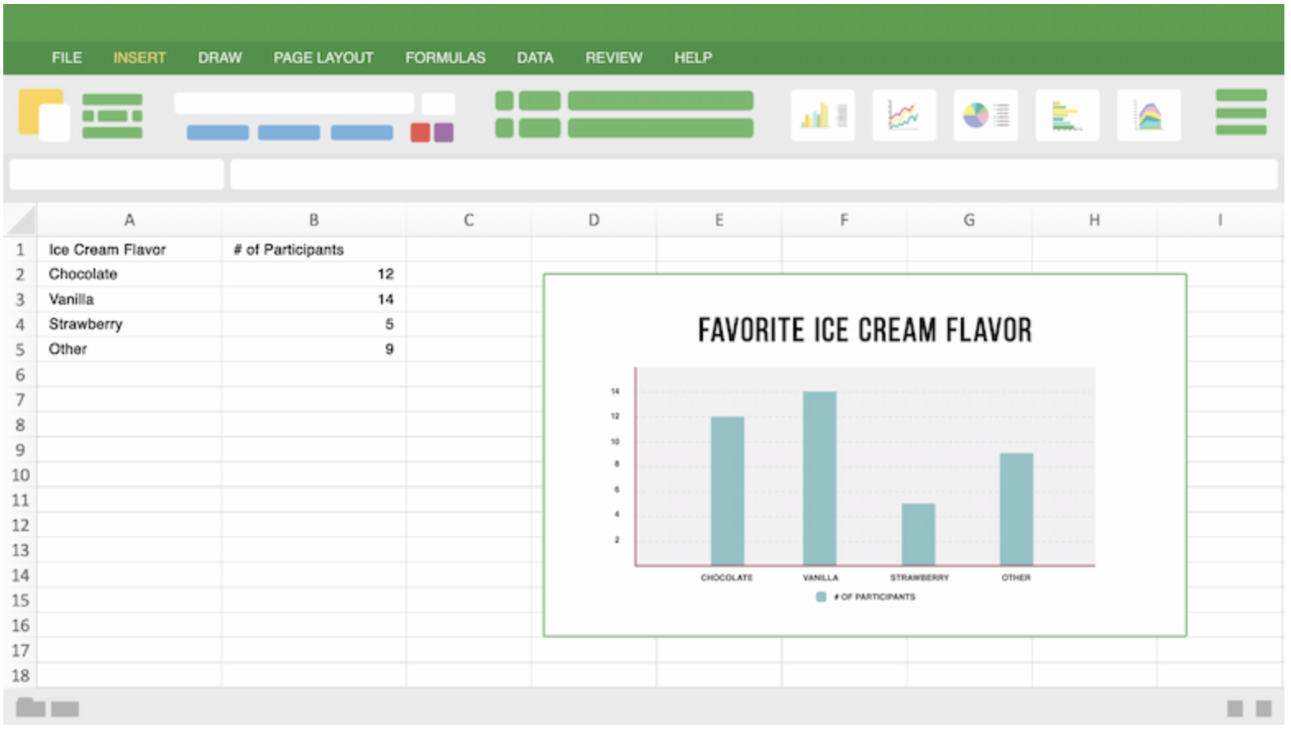
Easy to Produce Simple Charts

Slide 10
Math Functions in Excel (Examples)
Basic Mathematical Operations
SUM | Returns the sum of a supplied list of numbers
PRODUCT | Returns the product of a supplied list of numbers
POWER | Returns the result of a given number raised to a supplied power
SQRT | Returns the positive square root of a given number
QUOTIENT | Returns the integer portion of a division between two supplied numbers
MOD | Returns the remainder from a division between two supplied numbers
AGGREGATE | Performs a specified calculation (e.g. the sum, product, average, etc.) for a list or database, with the option to ignore hidden rows and error values
SUBTOTAL | Performs a specified calculation (e.g. the sum, product, average, etc.) for a supplied set of values
Matrix Functions
MDETERM | Returns the matrix determinant of a supplied array
MINVERSE | Returns the matrix inverse of a supplied array
MMULT | Returns the matrix product of two supplied arrays
MUNIT | Returns the unit matrix for a specified dimension
Advanced Mathematical Operations
SUMPRODUCT | Returns the sum of the products of corresponding values in two or more supplied arrays
SUMSQ | Returns the sum of the squares of a supplied list of numbers
SUMX2MY2 | Returns the sum of the difference of squares of corresponding values in two supplied arrays
SUMX2PY2 | Returns the sum of the sum of squares of corresponding values in two supplied arrays
SUMXMY2 | Returns the sum of squares of differences of corresponding values in two supplied arrays
SERIESSUM | Returns the sum of a power series
Factorials
FACT | Returns the Factorial of a given number
FACTDOUBLE | Returns the Double Factorial of a given number
MULTINOMIAL | Returns the Multinomial of a given set of numbers

Slide 11
Statistical Functions in Excel (Examples)
Function | Description
AVEDEV function | Returns the average of the absolute deviations of data points from their mean
AVERAGE function | Returns the average of its arguments
AVERAGEA function | Returns the average of its arguments, including numbers, text, and logical values
AVERAGEIF function | Returns the average (arithmetic mean) of all the cells in a range that meet a given criteria
AVERAGEIFS function | Returns the average (arithmetic mean) of all cells that meet multiple criteria
BETA.DIST function | Returns the beta cumulative distribution function
BETA.INV function | Returns the inverse of the cumulative distribution function for a specified beta distribution
BINOM.DIST function | Returns the individual term binomial distribution probability
BINOM.DIST.RANGE function | Returns the probability of a trial result using a binomial distribution
BINOM.INV function | Returns the smallest value for which the cumulative binomial distribution is less than or equal to a criterion value
CHISQ.DIST function | Returns the cumulative beta probability density function
CHISQ.DIST.RT function | Returns the one-tailed probability of the chi-squared distribution
CHISQ.INV function | Returns the cumulative beta probability density function
CHISQ.INV.RT function | Returns the inverse of the one-tailed probability of the chi-squared distribution
CHISQ.TEST function | Returns the test for independence
CONFIDENCE.NORM function | Returns the confidence interval for a population mean
CONFIDENCE.T function | Returns the confidence interval for a population mean, using a Student's t distribution
CORREL function | Returns the correlation coefficient between two data sets
COUNT function | Counts how many numbers are in the list of arguments
COUNTA function | Counts how many values are in the list of arguments
COUNTBLANK function | Counts the number of blank cells within a range
COUNTIF function | Counts the number of cells within a range that meet the given criteria
Z.TEST function | Returns the one-tailed probability-value of a z-test

Slide 12
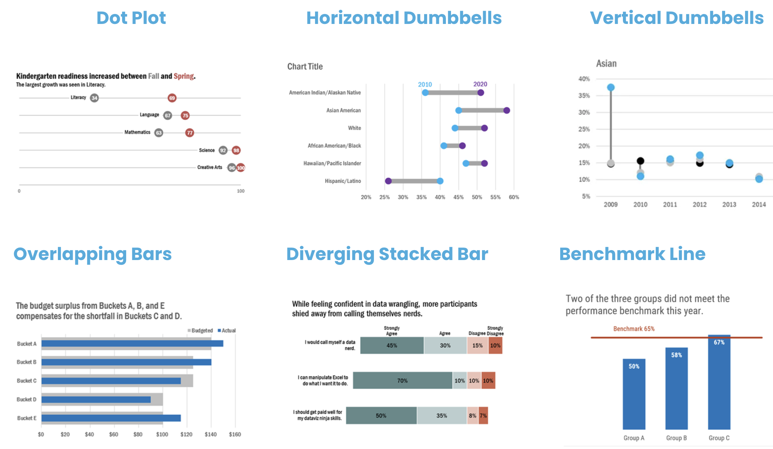
Advanced Charting in Excel

Slide 13
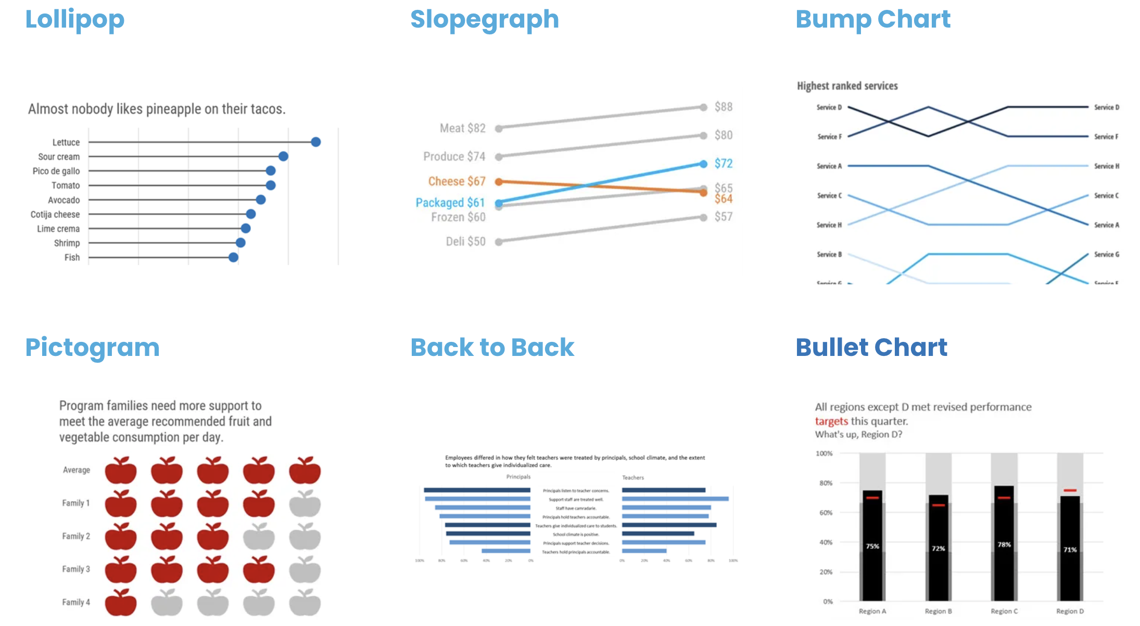
Advanced Charting in Excel

Slide 14
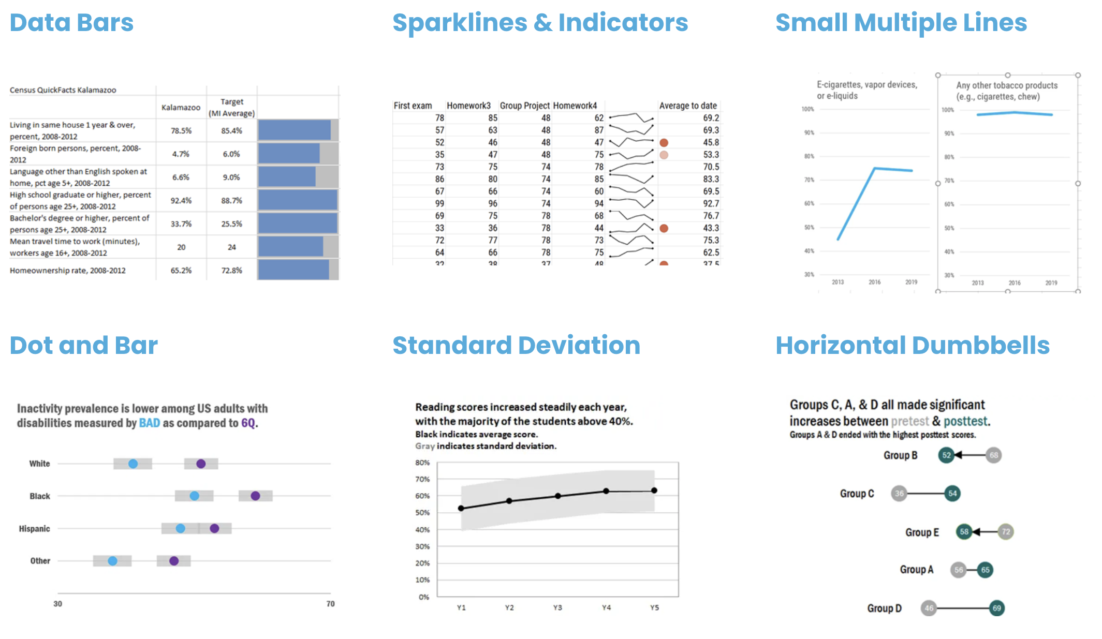
Advanced Charting in Excel

Slide 15
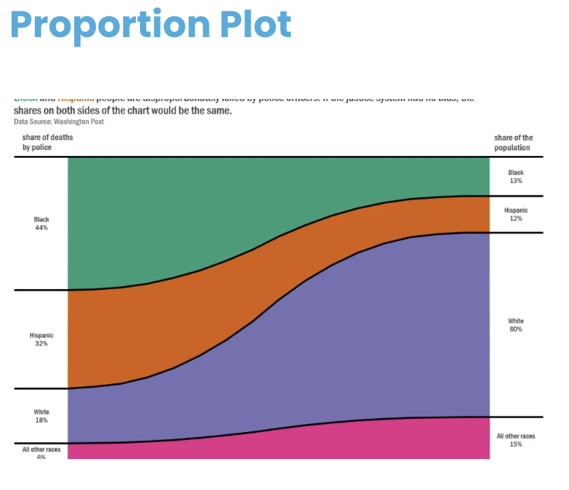
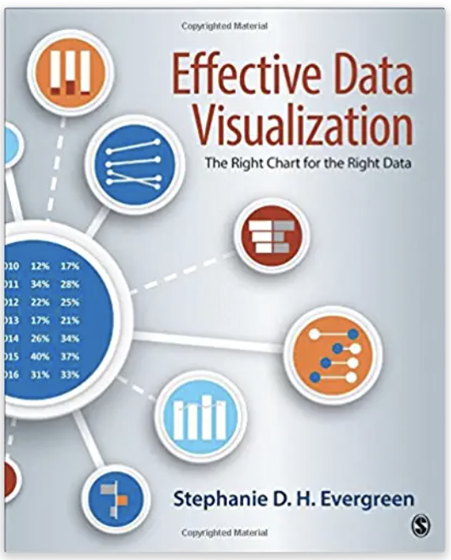
Charting in Excel
Effective Data Visualization: The Right Chart for the Right Data
Stephanie Evergreen
SAGE Publications, 2016
How to use MS Excel for data visualization & presentations
Examples from https://stephanieevergreen.com/how-to/

Slide 16
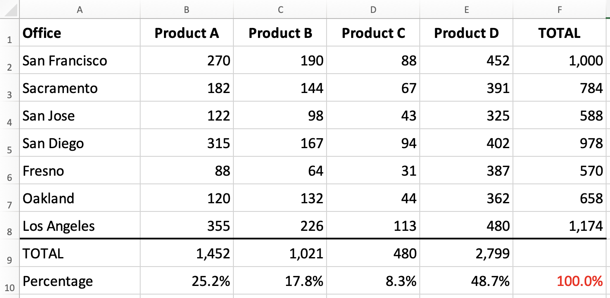
Basic Charting in Excel

Slide 17
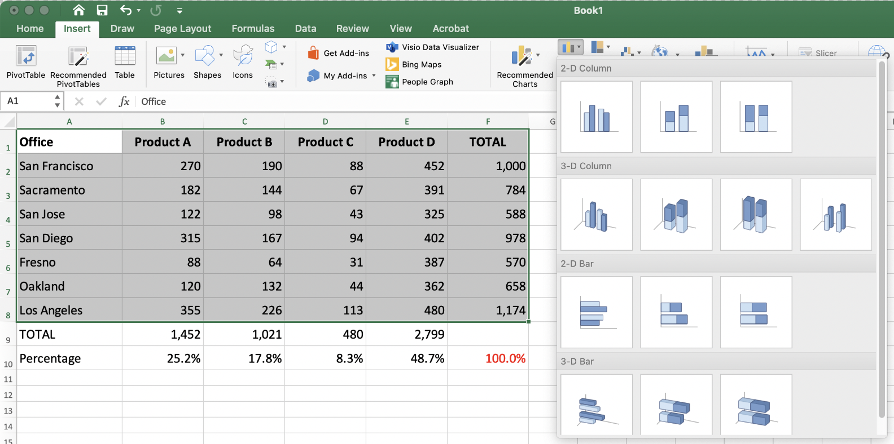
Horizontal Bar Chart

Slide 18
Bar Chart

Slide 19
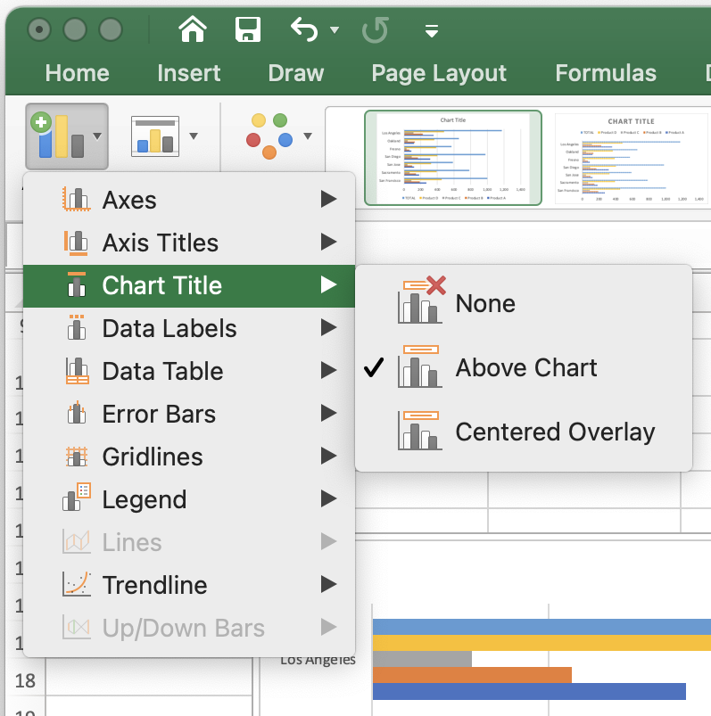
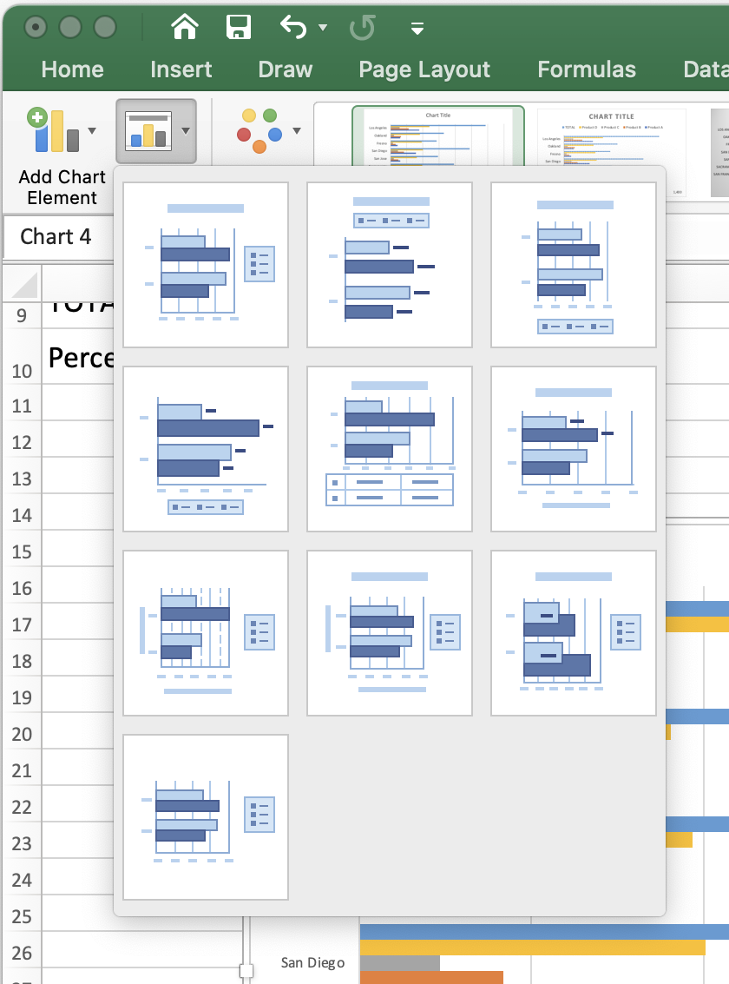
Tuning the Presentation

Slide 20
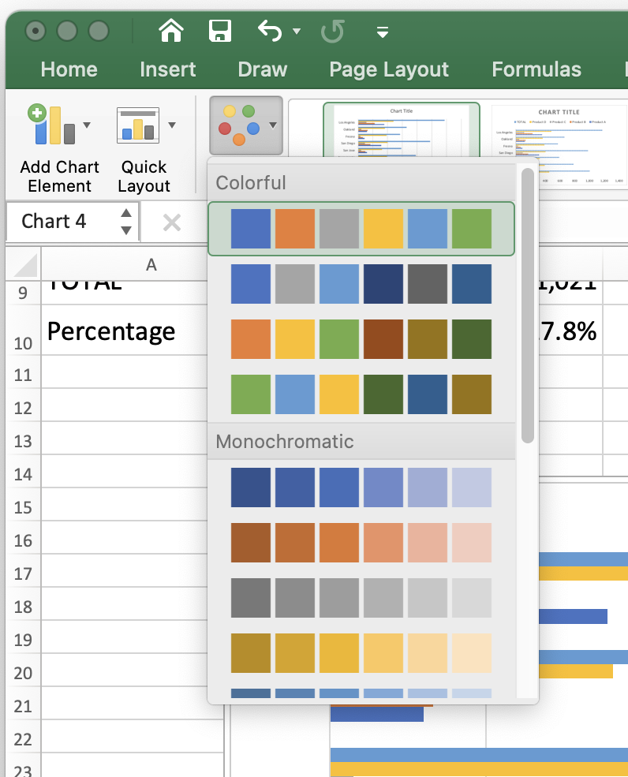
Tuning the Presentation

Slide 21
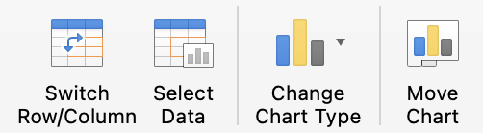
Changing the Presentation

Slide 22
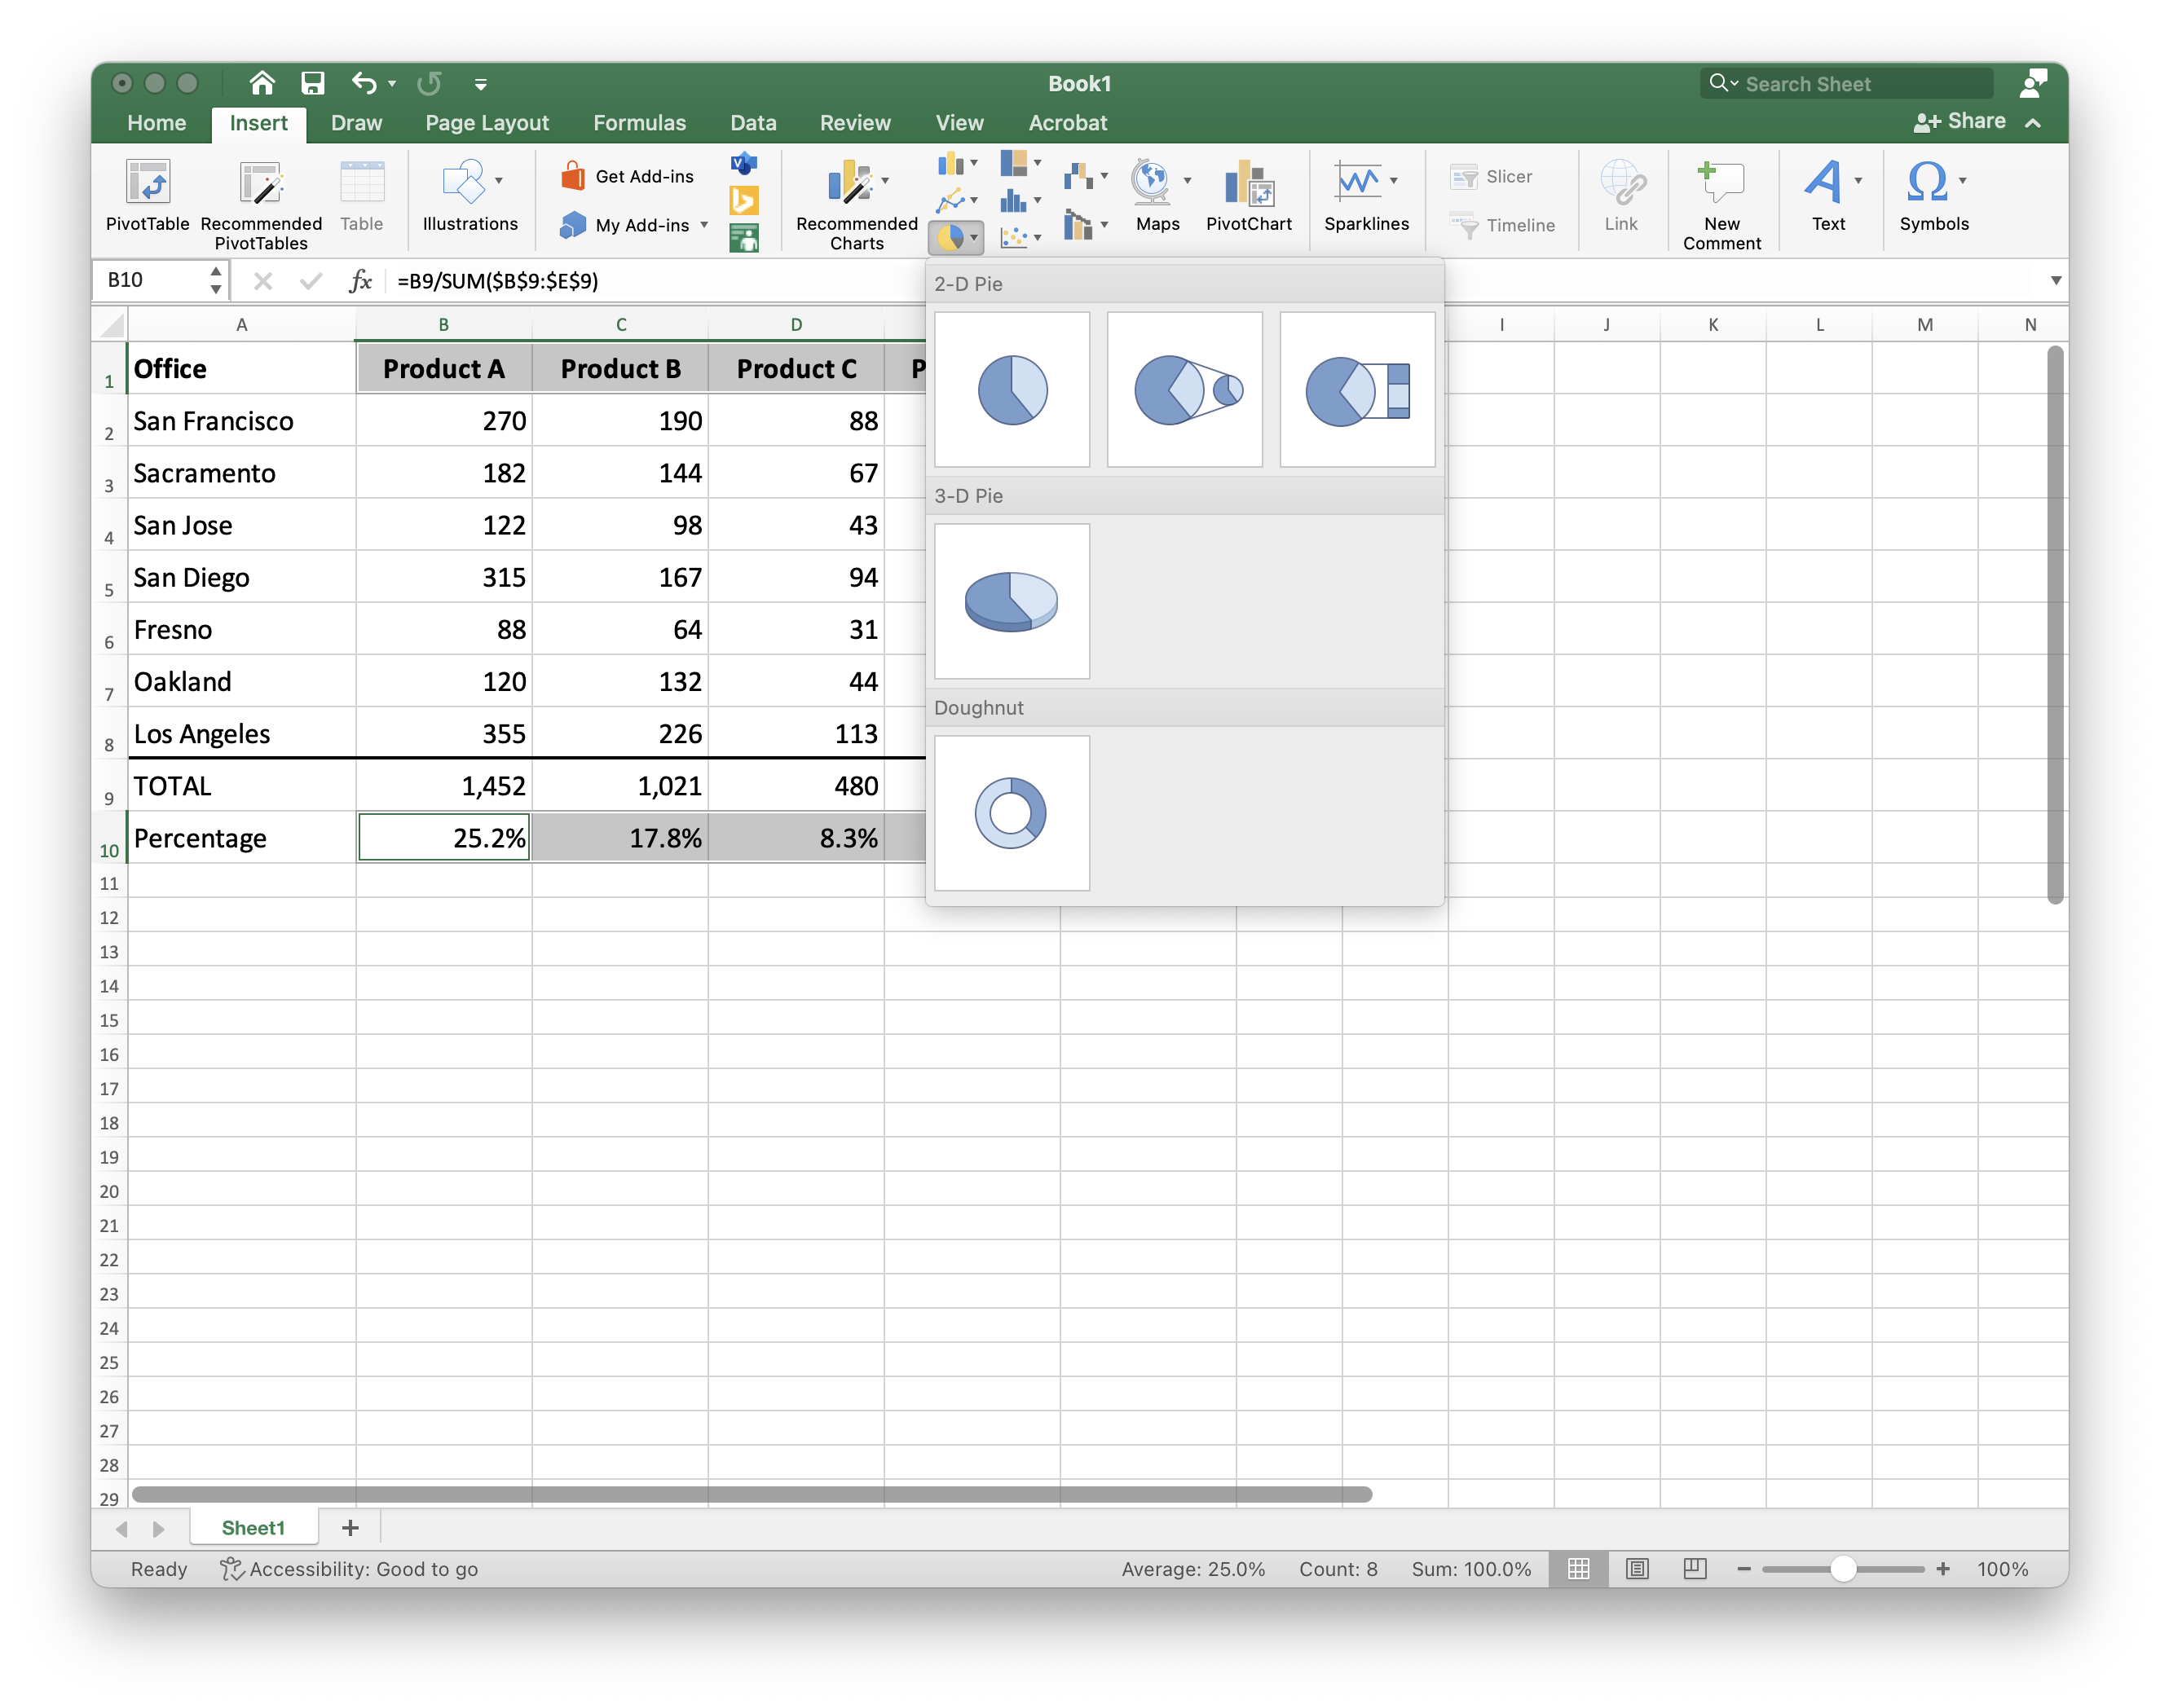
Pie Chart

Slide 23
Pie Chart
Integration of MS Products
After copying from Excel, this is still “live” content

Slide 24
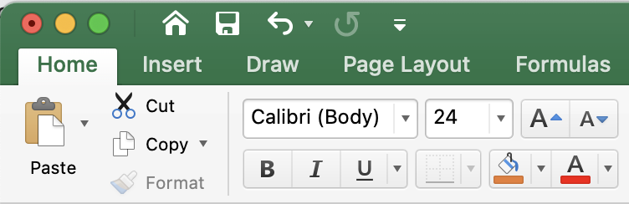
Tuning the Presentation

Slide 25
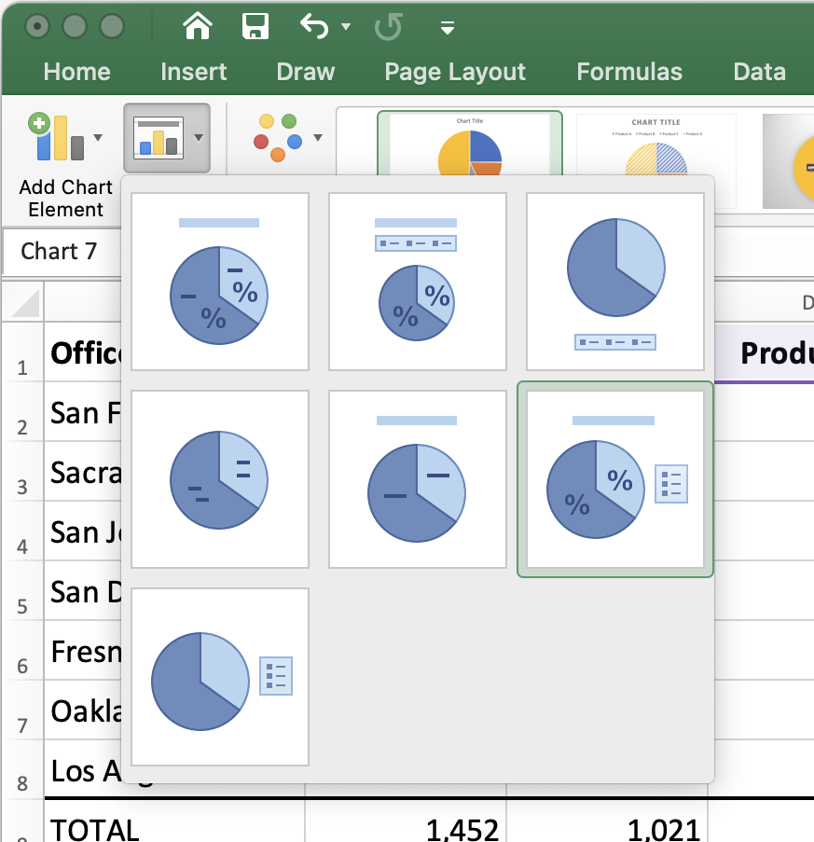
Tuning the Presentation

Slide 26
Fine Tuning

Slide 27
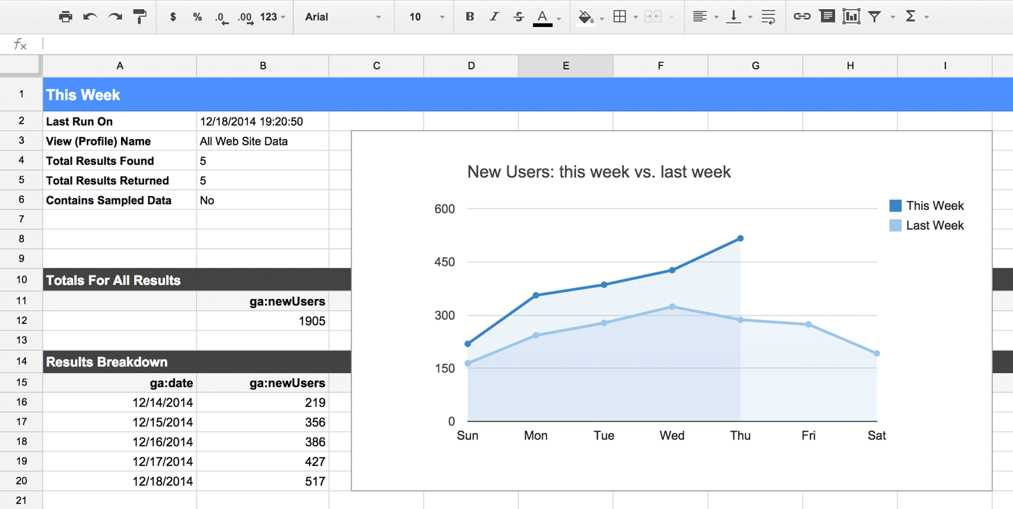
Google Sheets

Slide 28
Google Sheets Pros and Cons
Pros
Easy to share data
Becoming common
First released in 2006
Enormous development resources
Integrates with other Google Products
Google Analytics
Cons
A little harder to use than Excel
Web based – not always accessible
Not yet ubiquitous
Like Excel not suitable for Big Data

Slide 29
Data Analytics and Visualization in Python / Anaconda

Slide 30
Python Pros and Cons
Pros
Widely used by data scientists – easy to share
Powerful data analytics capabilities
Programmable
Matplotlib (2003), Seaborn, Bokeh, Plotly
Bokeh uses JSON & Javascript to produce “live” graphs
Cons
Requires programming
Matplotlib and Seaborn produce static graphs
Not suitable for Very Big Data

Slide 31
Jupiter Notebooks
Python is a programming language that can be run from the command line.
It has a large number of add-on libraries for data analytics and visualization
Jupiter Notebooks allow python code (and its output) to be opened in web browser.
Jupyter Notebooks can be exchanged with other data scientists that you may be working with

Slide 32
Installing Python
You can install Python and each of the libraries separately, but it’s easier to start with a “package”
https://www.anaconda.com/download
Python 3.9 version
Windows, MacOS, Linux
The installation includes:
IPython interpreter
Python standard libraries (including MatPlotlib & Seaborn)
Python data science libraries
Jupyter Notebooks server (runs inside a browser)
Text, graphs, Python code
Jupyter Lab

Slide 33
Matplotlib
Matplotlib is an easy-to-use, low-level data visualization library that is built on NumPy arrays. It consists of various plots like scatter plot, line plot, histogram, etc. Matplotlib provides a lot of flexibility.
To install this type the below command in the terminal.
pip install matplotlib

Slide 34
Dataset Used for Examples
Tips Dataset
Tips dataset is a record of the tips given by the customers in a restaurant for two and a half months in the early 1990s. It contains 6 columns such as total_bill, tip, sex, smoker, day, time, size of party.
You can download the tips database from Canvas

Slide 35
Matplotlib Line Chart
import pandas as pd
import matplotlib.pyplot as plt
# reading the database
data = pd.read_csv("tips.csv")
# Scatter plot with day against tip
plt.plot(data['tip'])
plt.plot(data['size'])
# Adding Title to the Plot
plt.title("Scatter Plot")
# Setting the X and Y labels
plt.xlabel('Day')
plt.ylabel('Tip')
plt.show()

Slide 36
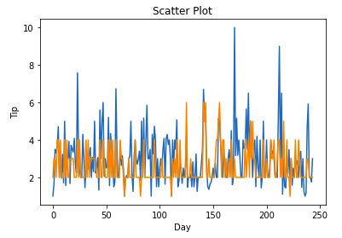
Matplotlib Line Chart

Slide 37
Seaborn
Seaborn is a high-level interface built on top of the Matplotlib. It provides a wider range of design styles and color palettes to make more attractive graphs.
To install seaborn type the below command in the terminal.
pip install seaborn

Slide 38
Seaborn Line Chart
# importing packages
import seaborn as sns
import matplotlib.pyplot as plt
import pandas as pd
# reading the database
data = pd.read_csv("tips.csv")
# using only data attribute
sns.lineplot(data=data.drop(['total_bill'], axis=1))
plt.show()

Slide 39
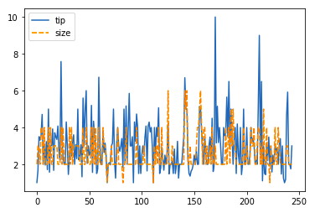
Seaborn Line Chart

Slide 40
Bokeh
Bokeh is mainly famous for its interactive charts visualization. Bokeh renders its plots using HTML and JavaScript that uses modern web browsers for presenting elegant, concise construction of novel graphics with high-level interactivity.
To install this type the below command in the terminal.
pip install bokeh

Slide 41
Bokeh Line Chart
# importing the modules
from bokeh.plotting import figure, output_file, show
import pandas as pd
# instantiating the figure object
graph = figure(title = "Bokeh Bar Chart")
# reading the database
data = pd.read_csv("tips.csv")
# Count of each unique value of
# tip column
df = data['tip'].value_counts()
# plotting the graph
graph.line(df, data['tip'])
# displaying the model
show(graph)

Slide 42
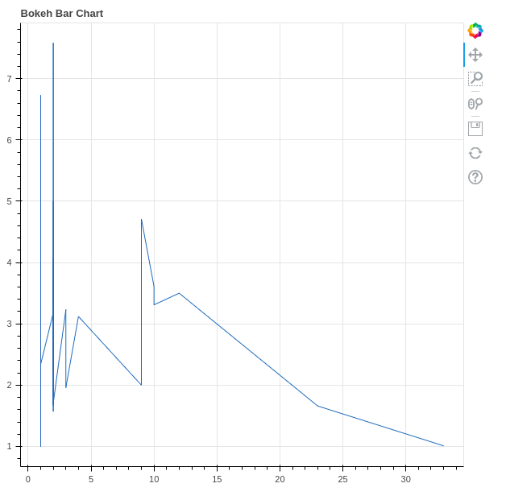
Bokeh Line Chart
Notice the tools
Bokeh allows users to zoom, pan, select elements, and even save the plot to a file.
The specific tools are configurable using options when you can bokeh

Slide 43
Bokeh Interaction
# importing the modules from bokeh.plotting import figure, output_file, show import pandas as pd # instantiating the figure object graph = figure(title = "Bokeh Bar Chart") # reading the database data = pd.read_csv("tips.csv") # plotting the graph graph.vbar(data['total_bill'], top=data['tip'], legend_label = "Bill VS Tips", color='green') graph.vbar(data['tip'], top=data['size'], legend_label = "Tips VS Size", color='red') graph.legend.click_policy = "hide" # displaying the model show(graph)
click_policy property makes the legend interactive. There are two types of interactivity:
Hiding: Hides the Glyphs.
Muting: Hiding the glyph makes it vanish completely, on the other hand, muting the glyph just de-emphasizes the glyph based on the parameters.

Slide 44
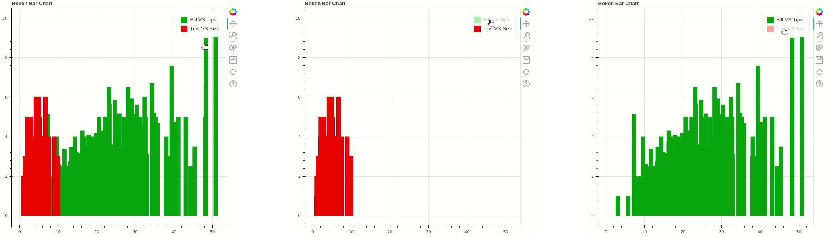
Bokeh Interaction

Slide 45
Plotly
Plotly has hover tool capabilities that allow us to detect any outliers or anomalies in numerous data points.
It allows more customization.
It makes the graph visually more attractive.
To install it type the below command in the terminal.
pip install plotly

Slide 46
Plotly Line Chart
import plotly.express as px
import pandas as pd
# reading the database
data = pd.read_csv("tips.csv")
# plotting the scatter chart
fig = px.line(data, y='tip', color='sex')
# showing the plot
fig.show()

Slide 47
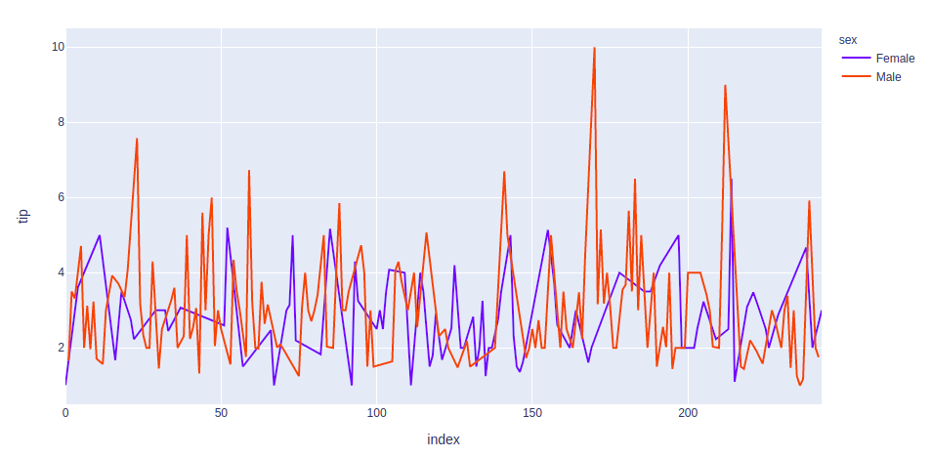
Plotly Line Chart

Slide 48
Assignment 3 – Due Next Week
You’ll submit a Jupyter Notebook (.ipynb) for this assignment.
Create a Python Notebook and load the tips.cvs dataset
You can use any of the plotting libraries shown in class
Each of the libraries has ways to tweak the appearance of graphs.
Produce three different chart types (e.g. line, bar, pie, scatter)
Try to show interesting aspects of the data. This may require some minor data transformation such as sums or averages.
Include comments in your Notebook explaining what you are showing and what the graph tells us.
When you submit your Notebook, name it lastname-Assignment3-ipynb

